Slide 1
Innovation Through Security
Roger Halbheer
Chief Security Advisor

Slide 2
We run three discussions
Engineering
Regulatory
Emotional
NEXT: <next slide title>

Slide 3
Intro: Messages to land
Business is seeing disruption
Security needs to enable the business
Continuous improvement cycle instead of compliance-driven rhythm
Zero Trust, Modern SOC, SecDevOps are key
Security drives innovation
NEXT: <next slide title>

Slide 4
The era of transformation
Risk management
Increasing cyberthreats
Security Architect
CISO
Enable DevOps
Compliance & Risk
Cloud Migration
Security
transformation
Digital transformation
Cloud
transformation
Business enabler
Talent gap
CEO
COO
Disparate security tools
CIO
Infra Manager
New competitive threats
Improve customer experience
Enable hybrid work
Support evolving business needs

Slide 5
The world is changing rapidly
Market
Business
Attacker
Technology
Security

Slide 6
Working together
Business
Market
Attacker
Technology
Security

Slide 7
Security Shifts to Continuous Improvement
Governance
Driving Continuous Improvement
Architecture
Innovate with
Assets
Posture Management
Innovation Security
SecDevOps
Access Assets
Access Control
Zero Trust
Asset
Protection
Security Operations
Policies and Standards
Cloud Security

Slide 8
Zero Trust: Messages to land
Zero Trust is not a product, it is a journey
Zero Trust is the modern version of security
Identity is at the core with devices coming immediately after (device management and Defender for Endpoints)
Zero Trust delivers simplification, automation, integration, and consolidation
This is a disruptive transformation
NEXT: <next slide title>

Slide 9
Access Control – Zero Trust

Slide 10
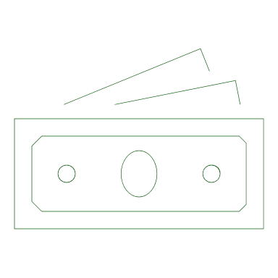


A Discussion on Different Levels
CEO
Digital Transformation
Business Drivers and Benefits
CFO
COO
CIO
CISO
Strategy
Enterprise Strategy and Priorities
Implementation
Implementation and Technical Architecture

Slide 11
Digital Transformation Business Drivers and Benefits

Slide 12


The digitized world is interconnected and dynamic
OT and IIoT
Home office
Cloud services
IoT device
Use Cases
Modern Security Imperatives
SaaS apps
Agility
Simplicity
Risk-Based
Automated Policy Enforcement
Adaptive Identity Management
Data-Driven Security
Asset-Centric Approaches
Normalization of remote work
Rapidly evolving partnerships and competitors
Rapidly changing communication patterns
Evolving national interests and regulations
Convergence of IT and OT
…
Company-owned device
Partners
Customers
Partner device
Identities
On-premises
Remote employees
Personal device

Slide 13
Protecting your assets
Innovate on Data
Know your data
Prevent
Data loss
Understand your data landscape and identify important data across your hybrid environment
Prevent accidental oversharing of sensitive information
Protect your data
Govern your data
Apply flexible protection actions including encryption, access restrictions and visual markings
Automatically retain, delete, and store data and records in a compliant manner
Powered by automation and integration

Slide 14
Key Zero Trust Components
Increase security assurances for your critical business assets
Data
Context
Identities
Security enforcement policy
Apps
Endpoints
Infrastructure
Control
Network
Visibility | Analytics | Automation

Slide 15
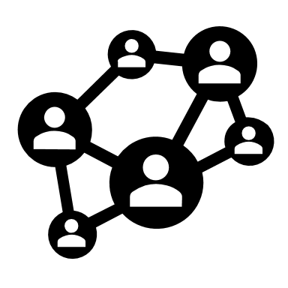







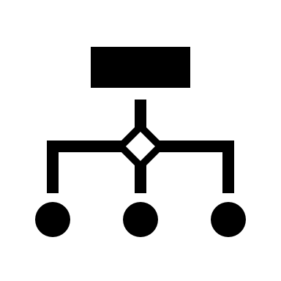
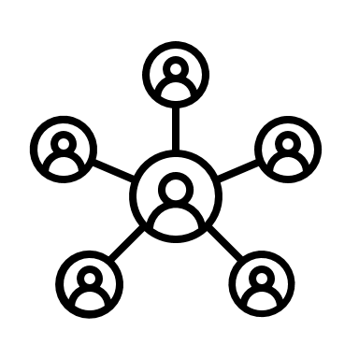

Key Zero Trust Components
Clarity, Automation, and Metrics-Driven Approach
Governance
Visibility and Policy
Access Control
Identity and Network - Multi-factor Authentication
Asset Protection
Classification, Protection, Tokenization
Security Policy Enforcement
Digital Ecosystems
Data/Information
</>
APIs
Apps & Systems
Threat Intelligence
Secured Zones
Modern Security
Operations
Rapid Threat Detection, Response, and Recovery

Slide 16
Building Cybersecurity Resilience
Shift Security from Quality Assurance to Business Enablement
Focus on Business Resiliency
Keep Security Risk in a Business Perspective
Invest in Trust and Relationships (internal and external)

Slide 17
Strategy Enterprise Strategy and Priorities

Slide 18
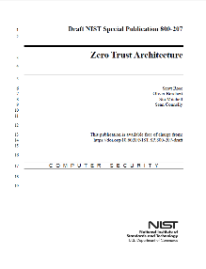
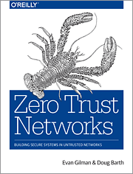
The History of Zero Trust
2004 Jericho Forum Formally Established
2014 Microsoft Advocates “Assume Breach”
2016 Conditional Access Released
Ongoing
Passwordless Initiative
~2004 Network Access Control (NAC) Architectures
2010 Forrester coins “Zero Trust” Term
2014 BeyondCorp Published
2017
2019
Zero Trust Architecture
Historically slow mainstream adoption for both network & identity models:
Network – Expensive and challenging to implement
Google’s BeyondCorp success is rarely replicated
Identity – Natural resistance to big changes
Security has a deep history/affinity with networking
Increasing consensus on convergence (though still ‘early days’ of this approach)

Slide 19
Zero Trust
Security Strategy for
business assets (data, applications, devices)
everywhere (private & public networks)
Simplify
Leads to Technical Initiatives
Integrate
User Access
Dynamic access control that explicitly validates trust before providing access
Modern SecOps
Pervasive detection and rapid response to attacks anywhere
OT and Datacenter
Monitor and protect existing and new assets by business risk
Automate
Consolidate
Increases security
Increases productivity

Slide 20







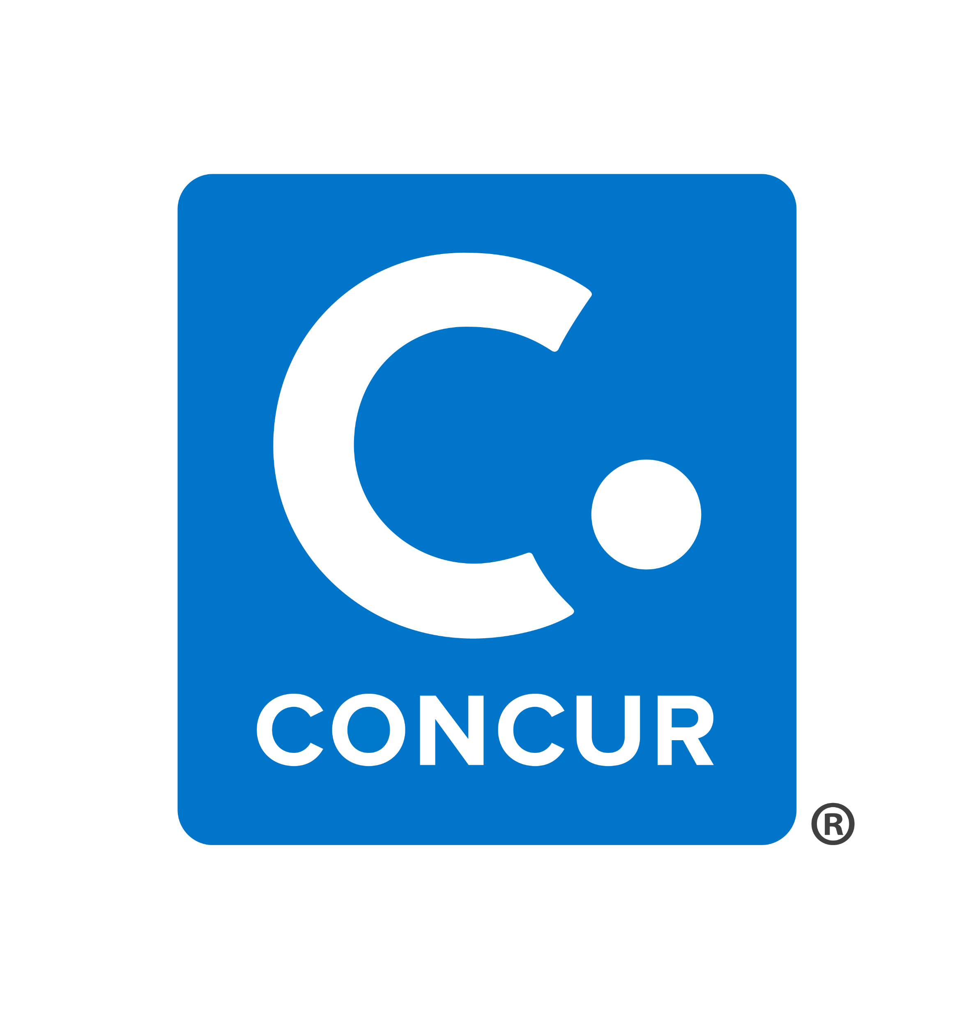
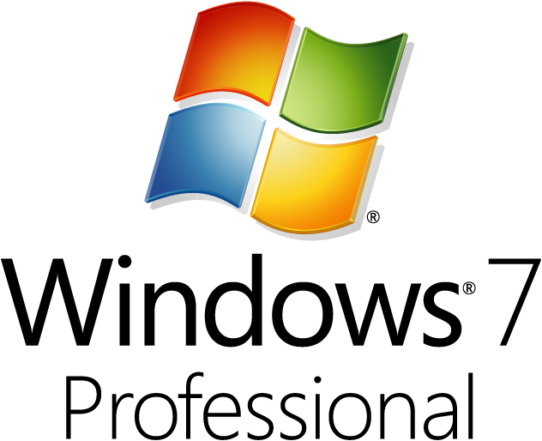


Network Transformation
Spans on-premises & Azure environments
Office
Azure
All Corporate Devices and Access
Managed CORP

Slide 21
Network Transformation
User Access Devices
Office
Azure
Unmanaged Internet
Sponsored Access
Event Access
BYOD
Access Varies based on trust & management level
Managed Internet
Managed Devices
Authenticated Devices
Validated Resource Access
All Devices can access internet
Managed and Compliant devices can access corporate resources
Limited general client access
Managed CORP
Spans on-premises & Azure environments

Slide 22
Network Transformation
User Access Devices
Office
Azure
Unmanaged Internet
Sponsored Access
Event Access
BYOD
Access Varies based on trust & management level
Managed Internet
Managed Devices
Authenticated Devices
Unmanaged devices for partners and employees
via Azure Virtual Desktop
VPN Access (Fallback)
Also used to discover remaining application access requirements
Published applications via Azure AD App Proxy
Validated Resource Access
All Devices can access internet
Managed and Compliant devices can access corporate resources
Limited general client access
Managed CORP
Spans on-premises & Azure environments

Slide 23
Network Transformation
User Access Devices
Office
Azure
Controlled / Sensitive Devices
Don’t Firewall and Forget
Unmanaged Internet
Sponsored Access
Event Access
BYOD
Business Critical and/or Legacy/Vulnerable Assets
Sensitive Business Units/Apps
Access Varies based on trust & management level
Managed Internet
Managed Devices
Authenticated Devices
High Impact IoT/OT
IoT/OT With Life/Safety Impact
Low Impact IoT/OT
Printers, VoIP phones, etc.
Validated Resource Access
All Devices can access internet
Managed and Compliant devices can access corporate resources
Managed CORP
Specialized Segments
Isolate well-defined Life/Safety and Business critical assets as possible
Spans on-premises & Azure environments

Slide 24
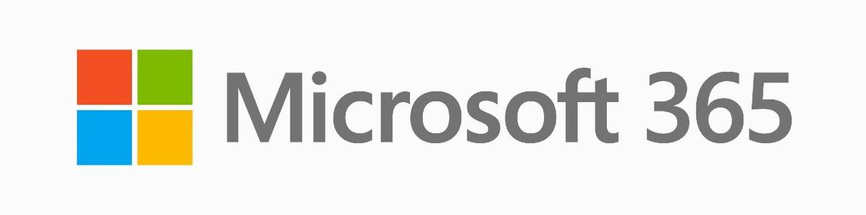











Network Transformation
Differentiated Workloads
Sanctioned and Managed Services
Internet and Unsanctioned/Unmanaged Apps
Private and Managed in the cloud or on-premises
Differentiated Devices
Differentiated Identities
Managed devices
Strongly managed identities
Policy based segmentation
MFA User
Admin
Managed identities
Access Varies based on trust & management level
Unmanaged devices
BYOD
User
Partner
Network Segments
Anonymous and Consumer identities
Business Critical Segment(s)
Sensitive Business Units/Apps
High Impact IoT/OT
IoT/OT With Life/Safety Impact
Low Impact IoT/OT
Printers, VoIP phones, etc.

Slide 25
Implementation Implementation and Technical Architecture

Slide 26



Define Zero Trust Principles
Verify explicitly
Use least privilege access
Assume breach
Always validate all available data points including
User identity and location
Device health
Service or workload context
Data classification
Anomalies
To help secure both data and productivity, limit user access using
Just-in-time (JIT)
Just-enough-access (JEA)
Risk-based adaptive polices
Data protection against out of band vectors
Minimize blast radius for breaches and prevent lateral movement by
Segmenting access by network, user, devices, and app awareness.
Encrypting all sessions end to end.
Use analytics for threat detection, posture visibility and improving defenses
Simplify, Integrate, Automate, Consolidate

Slide 27

Key Zero Trust Initiatives
Top Priorities – critical security modernization steps
User Access and Productivity
Explicitly validate trust for all access requests
Increase security for accessing key resources
Governance
Streamline response
Unify Visibility
Reduce manual effort
Modernize Security Operations
As Needed – typically driven by cloud adoption or OT/IoT usage
Operational Technology (OT) and Industrial IoT
Discover, Protect, Monitor
Datacenter & DevOps Security
Security Hygiene (Reduce Legacy Risk)
DevOps Integration
Microsegmentation

Slide 28
Key Zero Trust Initiatives
Roll out to IT Admins first
Targeted by Attackers
High potential impact
Provide technical feedback
Top Priorities – critical security modernization steps
Explicitly validate trust for all access requests (via Azure AD Conditional Access)
User Accounts - Require Passwordless or MFA for all users + measure risk with threat intelligence & behavior analytics
Devices - Require device integrity for access (configuration compliance first, then XDR signals)
Increase security for accessing key resources
Apps – Enable Azure AD for all SaaS, for VPN authentication, and publish legacy on-premises/IaaS via App Proxy
Data - Discover and protect sensitive data (via Cloud App Security, CA App Control, Microsoft Info Protection)
Governance to continuously monitor security posture and reduce risk (via Secure Score)
User Access and Productivity
Modernize Security Operations
Streamline response to common attacks with XDR for Endpoint/Email/Identity + Cloud (via M365 & Azure Defender)
Unify Visibility with modern Security Information and Event Management (SIEM via Azure Sentinel)
Reduce manual effort - using automated investigation/remediation, enforcing alert quality, & proactive threat hunting
As Needed – typically driven by cloud adoption or OT/IoT usage
Discover – Find & classify assets with business critical, life safety, and operational/physical impact (via Azure Defender for IoT)
Protect – isolate assets from unneeded internet/production access with static and dynamic controls
Monitor – unify threat detection and response processes for OT, IT, and IoT assets (via Azure Defender for IoT)
Operational Technology (OT) and Industrial IoT
Datacenter & DevOps Security
Security Hygiene – Rigorously monitor + remediate security configurations, security updates, MFA, and more
Reduce Legacy Risk – Retire or isolate legacy technology (Unsupported OS/Applications, legacy protocols)
DevOps Integration – Integrate infrastructure + development security practices into DevOps with minimal friction
Microsegmentation – Additional identity and network restrictions (dynamic trust-based and/or static rules)
ZT builds on classic security
Align to cloud migration schedule

Slide 29
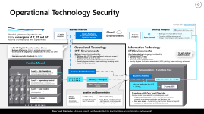
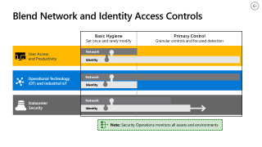
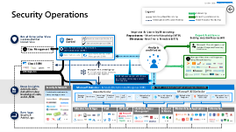
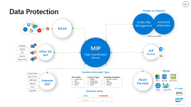
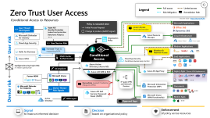
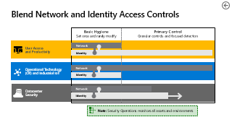
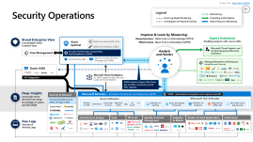
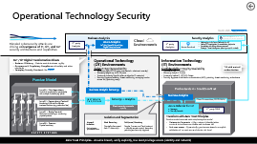
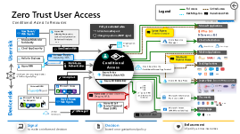
Zero Trust Architectures
Blend Access Controls
User Access and Productivity
Modern Security Operations
OT and IoT Environments
Information Protection

Slide 30
Blend Network and Identity Access Controls
Basic Hygiene Set once and rarely modify
Primary Control Granular controls and focused detection
User Access and Productivity
Network
Identity
Operational Technology (OT) and Industrial IoT
Network
Identity
Datacenter Security
Network
Identity
Note: Security Operations monitors all assets and environments

Slide 31






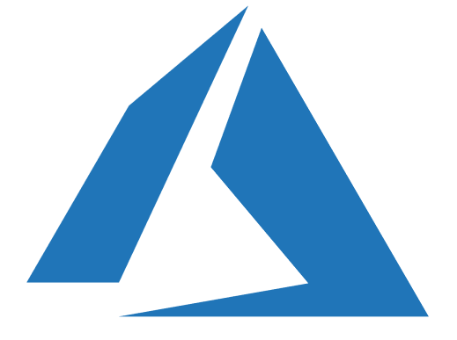





















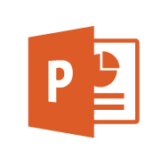
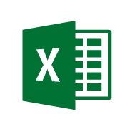



Zero Trust User Access
Legend
Full access
Limited access
Risk Mitigation
Remediation Path
Conditional Access to Resources
October 2020 – https://aka.ms/MCRA
Policy is evaluated when
Initial Access Request
Change in posture (AADIP signal)
Microsoft Applications
User Threat/ Risk Signals
Azure AD Identity Protection
Leaked cred protection
Behavioral Analytics
Lower Access
Restricted session
Office 365
Dynamics 365
Microsoft Defender for Identity
Azure Resource Manager
Cloud Infrastructure
Organization Policy
Cloud App Security
User/Session Risk
Azure Portal
Linux Login
User risk
Conditional Access
Modern Applications
Hello for Business
Increase Trust by requesting MFA
Monitor & Restrict Access
Azure MFA
Multi-Factor Authentication
Cloud App Security
Conditional Access App Control
SaaS Applications
Intelligent Security Graph (ISG)
8 Trillion Signals/Day
Azure Active Directory (Azure AD)
IsCompliant
Azure AD App Proxy
Azure AD B2B & B2C
Legacy Apps (Secure VPN Replacement )
Partner MDM
Microsoft Intune
3rd party VPN and Network Devices
{LDAP}
Remediate Leaked Credential (Requires MFA)
Microsoft Information Protection (MIP)
Microsoft Defender for Endpoints
Device Threat/ Risk Signals
Documents
Device risk
Azure AD Self Service Password Reset (SSPR)
Microsoft Intune (MAM functionality)
Mobile Apps
Active Directory
IsManaged
Approved Apps
Signal to make an informed decision
Decision based on organizational policy
Enforcement of policy across resources

Slide 32



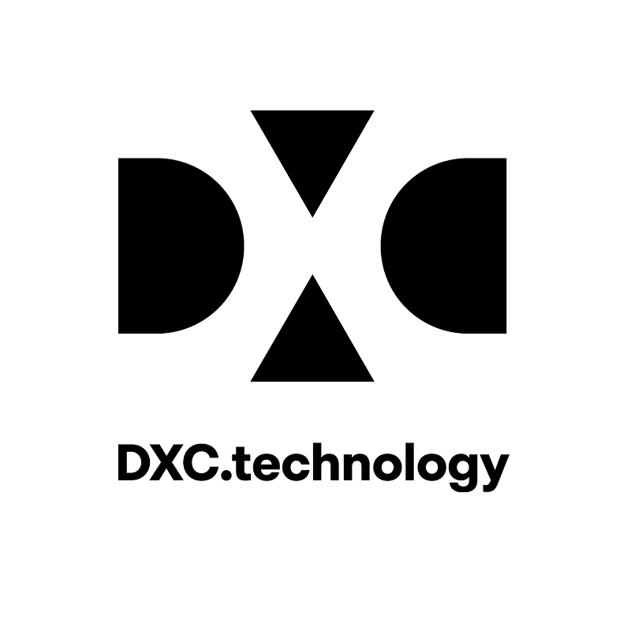




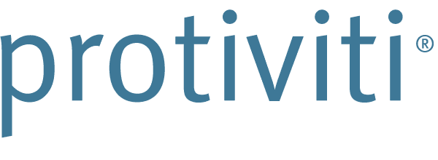























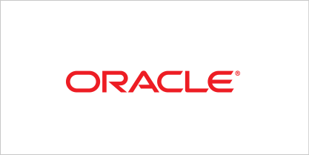




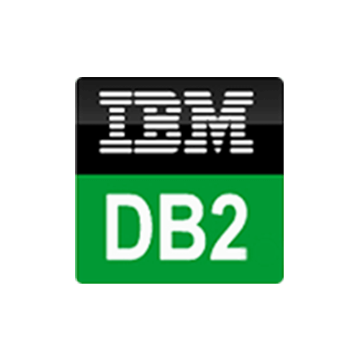
Security Operations
October 2020 – https://aka.ms/MCRA
Legend
Outsourcing
Event Log Based Monitoring
Consulting and Escalation
Investigation & Proactive Hunting
Native Resource Monitoring
Improve & Learn by Measuring:
Responsiveness - Mean time to Acknowledge (MTTA)
Effectiveness- Mean Time to Remediate (MTTR)
Broad Enterprise View
Correlated/Unified Incident View
Azure Sentinel
Expert Assistance
Enabling analysts with scarce skills
Machine Learning (ML) & AI
Behavioral Analytics (UEBA)
Microsoft Threat Experts, and Incident Response/Recovery Assistance
(Case Management
Security Orchestration, Automation, and Remediation (SOAR)
Analysts and Hunters
Security Data Lake
Security Incident & Event Management (SIEM)
Managed Detection and Response
Using Microsoft Security
(Classic SIEM
API integration
Microsoft Threat Intelligence 8+ Trillion signals per day of security context & Human Expertise
SOAR reduces analyst effort/time per incident, increasing overall SOC capacity
Deep Insights Actionable alerts derived from deep knowledge of assets, and ML/UEBA
Microsoft Defender – Extended Detection and Response (XDR)
Security & Network
SOAR - Automated investigation and response (AutoIR)
Provide actionable security alerts, raw logs, or both
Azure Defender
Microsoft 365 Defender
Servers & VMs
Containers
Azure app services
Network traffic
SQL
IoT & OT
Defender for Identity
Azure AD Identity Protection
Defender for Endpoint
Defender for Office 365
Microsoft Cloud App Security
Infrastructure & Apps
PaaS
OT & IoT
Identity & Access Management
Endpoint & Mobile
Modern & SaaS Applications
Information
Raw Logs Security & Activity Logs
Office 365
{LDAP}

Slide 33





Operational Technology Security
November 2020 – https://aka.ms/MCRA
Business Analytics
Security Analytics
Cloud Environments
Threat Intelligence – 8+ Trillion signals per day of security context
Blended cybersecurity attacks are driving convergence of IT, OT, and IoT security architectures and capabilities
3rd party
Analytics
Azure Analytics
IoT Hub, PowerBI, Azure Edge, Digital Twins, and more
3rd party
Analytics
Native plug-in for Azure Defender for IoT
Native OT investigation & remediation playbooks
Correlation with other data sources and Strategic Threat intelligence (attack groups & context)
Azure Sentinel
IIoT / OT Digital Transformation drivers
Business Efficiency - Data to enable business agility
Governance & Regulatory Compliance with safety and other standards
Emerging Security Standards like CMMC
Operational Technology (OT) Environments
Information Technology (IT) Environments
Safety/Integrity/Availability
Hardware Age: 50-100 years (mechanical + electronic overlay)
Warranty length: up to 30-50 years
Protocols: Industry Specific (often bridged to IP networks)
Security Hygiene: Isolation, threat monitoring, managing vendor access risk, (patching rarely)
TLS with mutual authentication
Confidentiality/Integrity/Availability
Hardware Age: 5-10 years
Warranty length 3-5 years
Protocols: Native IP, HTTP(S), Others
Security Hygiene: Multi-factor authentication (MFA), patching, threat monitoring, antimalware
SAFETY SYSTEMS
Purdue Model
Level 3 – Site Operations Control & monitoring for physical site with multiple functions (e.g. plant)
Business Analytic Sensor(s)
Purdue Levels 4 + 5 and Zero Trust
Business Analytics
Level 2 – Supervisory Control Monitoring & Control for discrete business functions (e.g. production line)
NETWORK TAP/SPAN
Sensor(s) + Analytics
Cloud Connection (OPTIONAL)
Plant security console
(optional)
Azure Defender for IoT
Manager
Security Console
3rd party SIEM
Level 1 – Basic Control Electronics controlling or monitoring physical systems
Isolation and Segmentation
Transform with Zero Trust Principles
Purdue model assumed static site/enterprise model
Datacenter Segments – Align network/identity/other controls to business workloads and business risk
End user access - Dynamically grant access based on explicit validation of current user and device risk level
Level 0 – Process Physical machinery
Internal isolation
As business processes allow
Hard Boundary
Physically disconnect from IT network(s)
Soft(ware) Boundary
People, Process, and Tech (network + identity access control, boundary patching and security hygiene)
Zero Trust Principles - Assume breach, verify explicitly, Use least privilege access (identity and network)

Slide 34











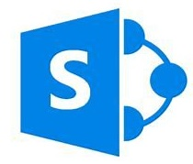

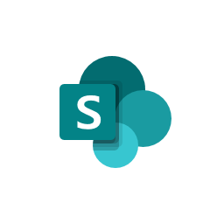








Data Protection
Visibility and Analytics
Insider Risk Management
Advanced eDiscovery
MCAS
Informed by MIP
Windows
MIP
Data Classification Service
MacOS
Office 365
DLP
AIP Scanner
iOS
Android
Office online
Sensitive Information Types
Azure
Cloud Upload
App Control
Out of Box
Credit Card
SSN
License
More
Custom Types
RegEx
Dictionary
Fingerprint
EDM
Trainable Classifiers
Sample Content
Test
Validate
Publish
USB Drive
Endpoint DLP
Azure Purview
ADLS
SQL DB
Azure Files
Network
Print
3rd Party
Clipboard
Sensitivity Labels
Blobs
Cosmos DB
Public
Confidential
General
…

Slide 35
Start Zero Trust Today
Start with quick wins
Plan for incremental progress
Zero Trust Deployment Guidance - https://aka.ms/ZTGuide
User Access and Productivity
Modernize Security Operations
Operational Technology (OT) and Industrial IoT
Datacenter Security

Slide 36

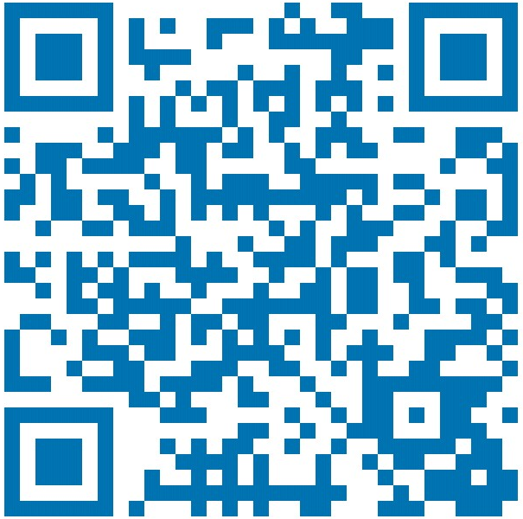
Thank you
Roger Halbheer
roger.halbheer@microsoft.com
+41 78 844 65 55

Slide 37
Modern SOC: Messages to land
Tools need to be integrated
Automation is key
Drives towards lower Mean-time to Remediate – Minutes matter
NEXT: <next slide title>

Slide 38
Modern SOC

Slide 39
The digitized world is interconnected and dynamic
OT and IIoT
Home office
Cloud services
IoT device
Use Cases
Modern Security Imperatives
SaaS apps
Agility
Simplicity
Risk-Based
Automated Policy Enforcement
Adaptive Identity Management
Data-Driven Security
Asset-Centric Approaches
Normalization of remote work
Rapidly evolving partnerships and competitors
Rapidly changing communication patterns
Evolving national interests and regulations
Convergence of IT and OT
…
Company-owned device
Partners
Customers
Partner device
Identities
On-premises
Remote employees
Personal device

Slide 40

The digitized world is interconnected and dynamic
OT and IIoT
Home office
Cloud services
IoT device
Use Cases
Modern Security Imperatives
Modern SOC Imperatives
SaaS apps
Agility
Simplicity
Risk-Based
Automated Policy Enforcement
Adaptive Identity Management
Data-Driven Security
Asset-Centric Approaches
Speed: Minutes matter!
Coverage inside and outside the network
Fast and reliable integration (Cloud, Identity, OT…)
Focus the (limited) analysts on value add
High true positive rate
Introduce Hunting
Normalization of remote work
Rapidly evolving partnerships and competitors
Rapidly changing communication patterns
Evolving national interests and regulations
Convergence of IT and OT
…
Company-owned device
Partners
Customers
Partner device
Identities
On-premises
Remote employees
Personal device

Slide 41
SOC Challenges
Speed / Automation
Agility
Coverage
Integration

Slide 42
Focus Topics
Tooling
Use the right tool for the job
Culture
Reduce toil
Metrics
Measure the right things

Slide 43
Culture

Slide 44
SIEM Development Phases
Stage 2
Stage 1
Stage 0
SOC State
Technology
People
Processes
Posture Mgmt.
Threat Intell.

Slide 45
SIEM Development Phases
Stage 2
Stage 1
SOC State
Technology
People
Processes
Posture Mgmt.
Threat Intell.
Stage 0
Manual
Opportunistic
Small Team
Informal
Unstructured
Partly automated
Unstructured

Slide 46
SIEM Development Phases
Stage 2
SOC State
Technology
People
Processes
Posture Mgmt.
Threat Intell.
Stage 1
Partly automated
Opp. Red Team
Manual hunting
Struct. operations
Hunting platform
Different roles
Clear training
Documented
Metrics
Tailored Use Cases
Central Patch Mgmt
SW Lifecycle Mgmt
Different sources
Threat Summary
Stage 0
Manual
Opportunistic
Small Team
Informal
Standard Use Cases
Unstructured
Partly automated
Unstructured

Slide 47
SIEM Development Phases
SOC State
Technology
People
Processes
Posture Mgmt.
Threat Intell.
Stage 2
Autom. Response
Standing Red Team
ML/AI for hunting
Ops processes
Tight integration
Automation
Well-structured
Certified
Job rotation
Auto. Improvement
Business-aligned
24*7
Auto. enforcement
TI platform
Business-aligend
Stage 1
Partly automated
Opport. Red Team
Manual hunting
Struct. operations
Hunting platform
Different roles
Clear training
Documented
Metrics
Tailored Use Cases
Central Patch Mgmt
SW Lifecycle Mgmt
Different sources
Threat Summary
Stage 0
Manual
Opportunistic
Small Team
Informal
Standard Use Cases
Unstructured
Partly automated
Unstructured

Slide 48
Security Operations Model – Functions and Tools
Threat Intelligence
External Intelligence Sources
Partner Teams IT Operations, DevOps, & Insider Threat, and more
Strategic and Business Threat Insights/Trends
Hunt (TIER 3) Proactive Hunting, Advanced Forensics, and Detection Tuning Any/All tools, data, intelligence sources
Major Incident
Incident Management
Business Coordination
Assess Impact & Manage Stakeholders
High Complexity Incidents
Escalations & multi-stage incidents
Alerts on business-critical assets
Monitoring known campaigns
Investigation (TIER 2) Advanced Analysis and Remediation
Primary Tools: XDR (Microsoft 365 Defender & Azure Defender)
Triage (TIER 1) Rapid Remediation or Escalation
Primary Tools: XDR (Microsoft 365 Defender & Azure Defender)
High Volume Incidents
High true positive rate
Consistent/predictable
CDOC Example Alert Ratio :
XDR Alerts (~65%)
User Reporting (~10%)
Log/Event/Other (~25%)
AUTOMATION Automated Investigation & Remediation
Well known attacks
XDR (Microsoft 365 Defender and Azure Defender) Alerts
Tactical Threat Trends and Indicators of Compromise (IOCs)

Slide 49
Silos are the Bane of SOC Analysts
Attackers traverse rapidly across the enterprise
Defender Silos makes life difficult (even with SIEM)
MAPPING CHALLENGES
Email & Collab
Applications
Network IP address
Computer Name
Documents
Device ID
Email
Etc.
Identity
Endpoint
Others
Silos must be integrated to provide high quality alerts and correlation

Slide 50


Simplifying and Automating
Azure Sentinel
Single Portal Experience
Microsoft Defender
Incidents, investigations, threat hunting, threat analytics
Playbook Automation
Protect
Investigate
Remediate
Semantics and Meaning
Event
Alert
Incident
Mappings
Unified entity definitions
#.#.#.#
Signal sharing
Intelligent Capabilities
Email & Collab
Applications
Identity
Endpoint
Others

Slide 51


The Frist Big Challenge
Detect
Respond
CONCERN 1: Miss real detections while chasing false positives
CONCERN 2: Attackers operate freely until remediated

Slide 52
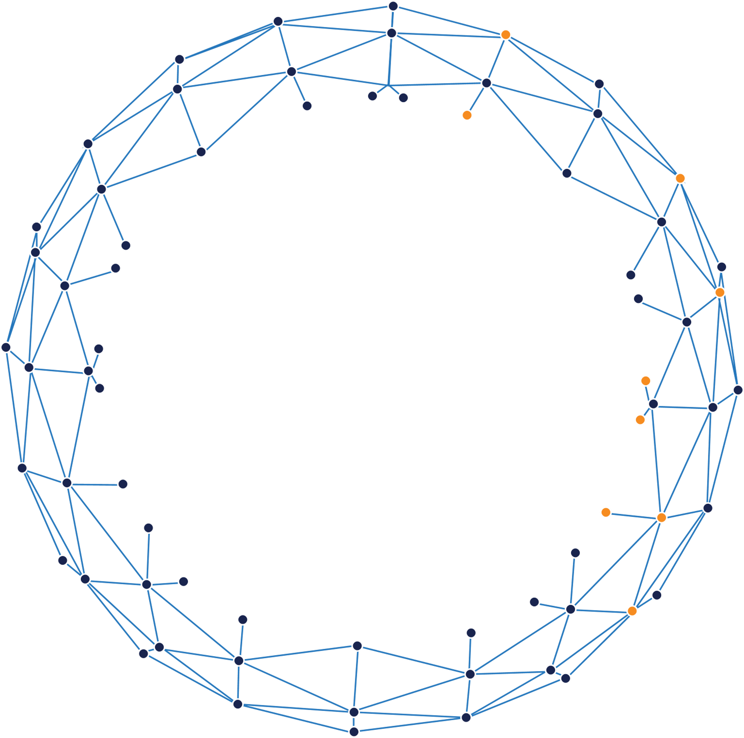
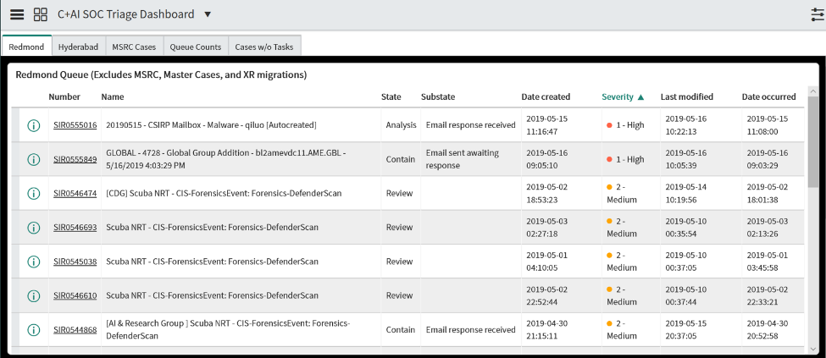

The Approach
Detect
Respond
Billions of events per month
Enforce 90% true positive on alert feeds
Machine Learning (Artificial Intelligence)
Focus on time to acknowledge and remediate
Behavioral Analytics (UEBA) (User and Entity)
Security Orchestration, Automation, and Remediation (SOAR)
Billions of events per month
Hundreds of investigations
Dozens of investigations

Slide 53
Tooling

Slide 54
Tooling starts with classical SIEM
Major challenges with this approach
Event volume
Alert overload/false positives
Poor investigation workflow
Microsoft and 3rd-party tools
(as needed)
Malware-less attacks
“File-less” malware
SIEM
Tailored/targeted malware
Mass distribution malware
Alert queue
Primary investigation
Pivot and remediate

Slide 55
Modern SOC Model
Advanced SIEM working with specialized solutions
SIEM
+ SOAR as a Service
Microsoft and 3rd-party tools
(as needed)
Azure Sentinel​
Malware-less attacks
Endpoint – Microsoft Defender ATP Endpoint Detection & Response (EDR)
Identity – Azure ATP + Azure AD Identity Protection
“File-less” malware
SaaS – Office 365 Advanced Threat Protection (ATP) + Cloud App Security
Tailored/targeted malware
Azure assets – Azure Security Center
Mass distribution malware
Network – 3rd-party logs and tools
Servers – 3rd-party and Microsoft logs and tools
Options – 3rd-party and Microsoft logs and tools
Built on Azure Monitor, Logic Apps, and Microsoft’s UEBA/ML Technology

Slide 56


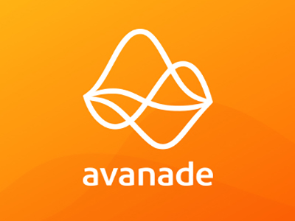





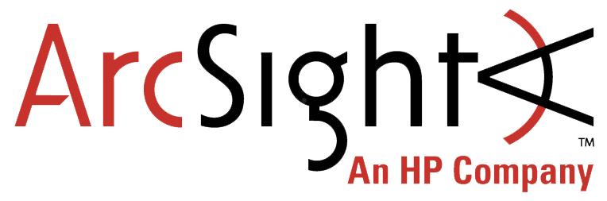


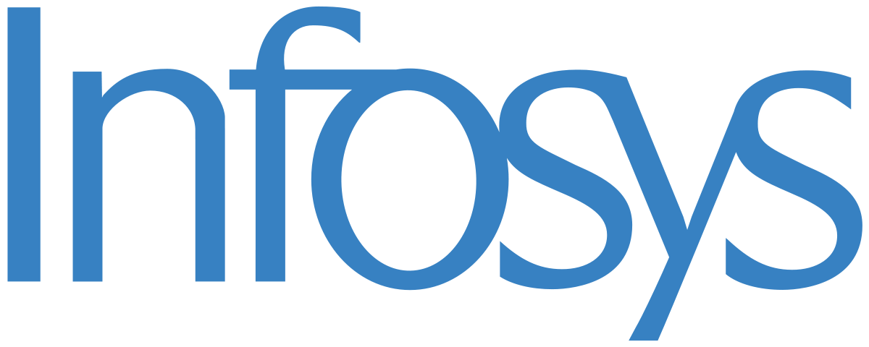





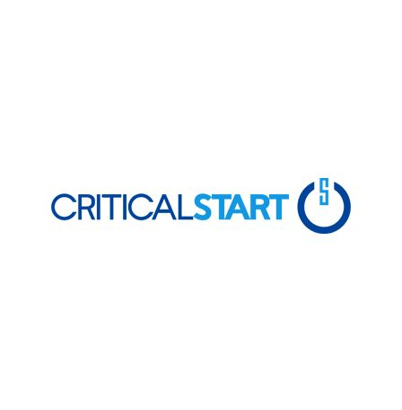

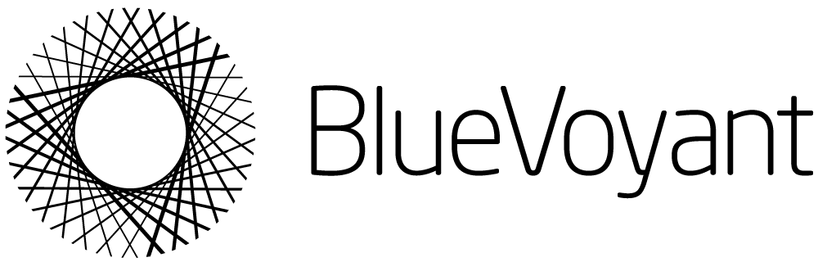
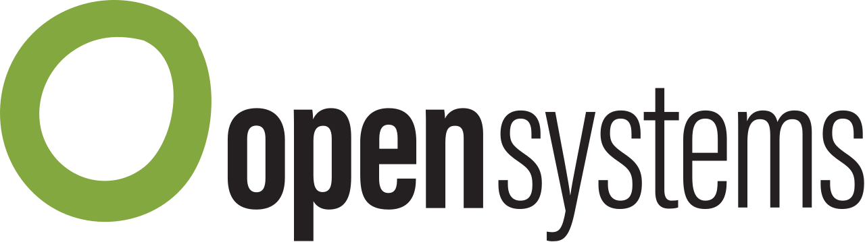

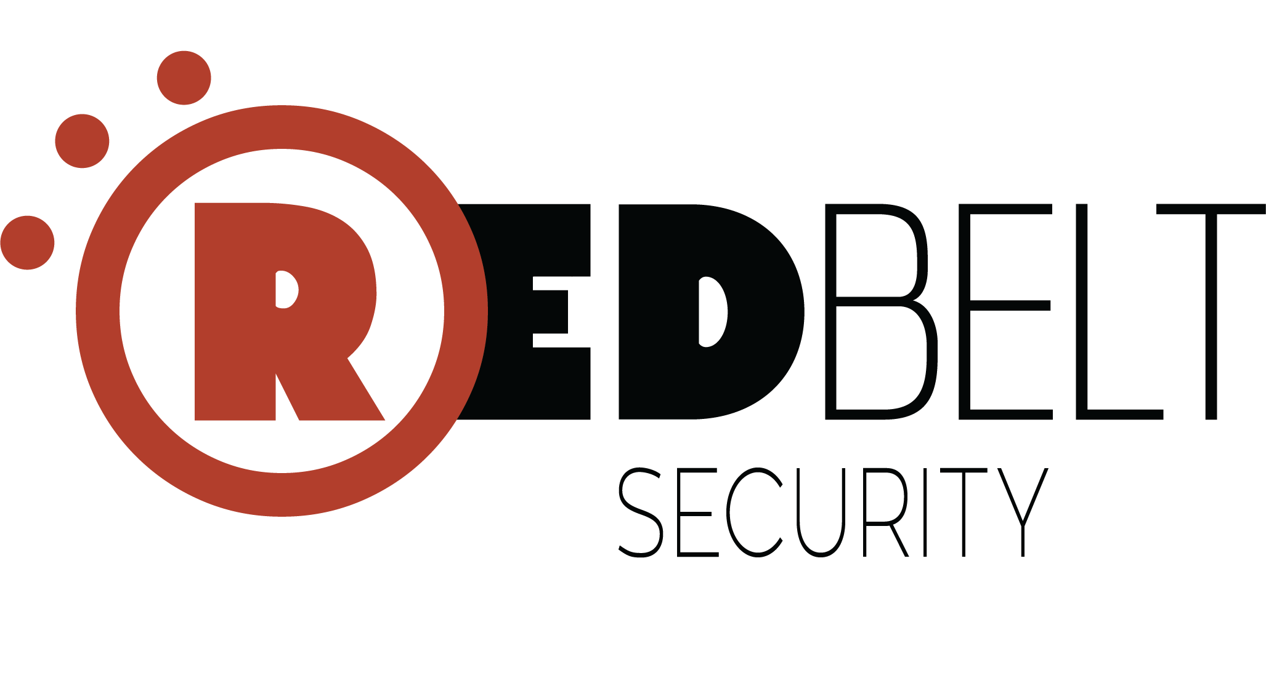
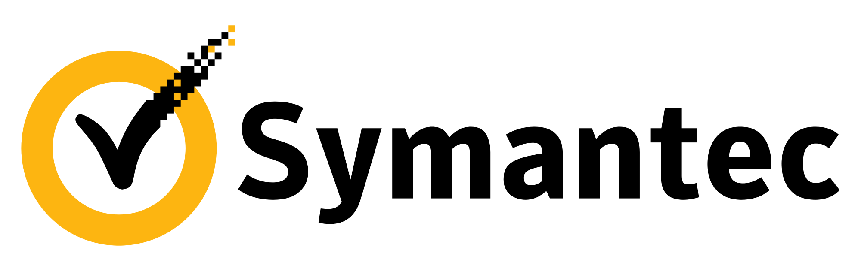






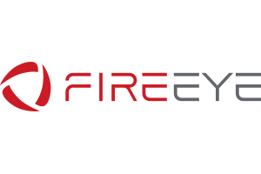


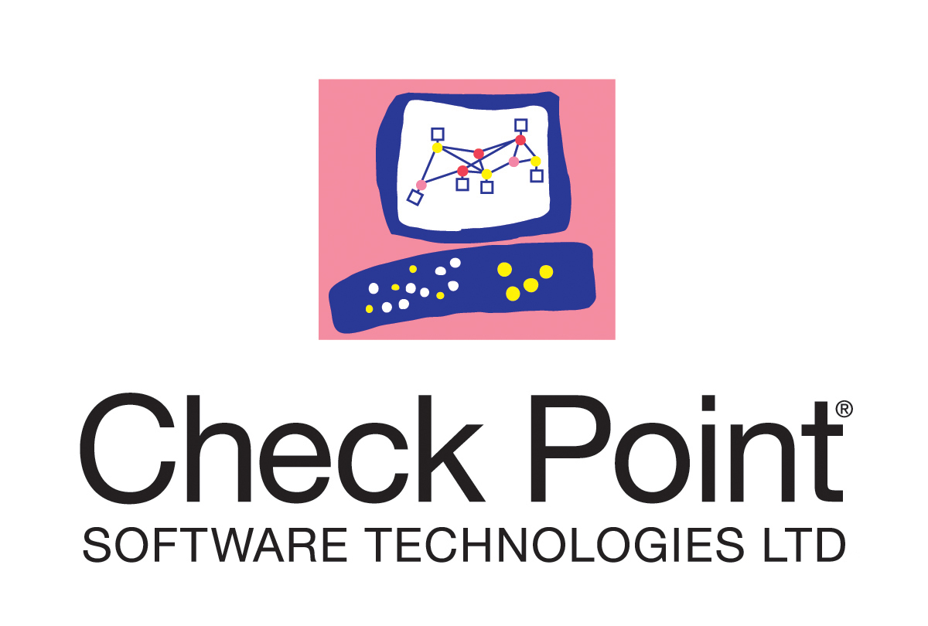
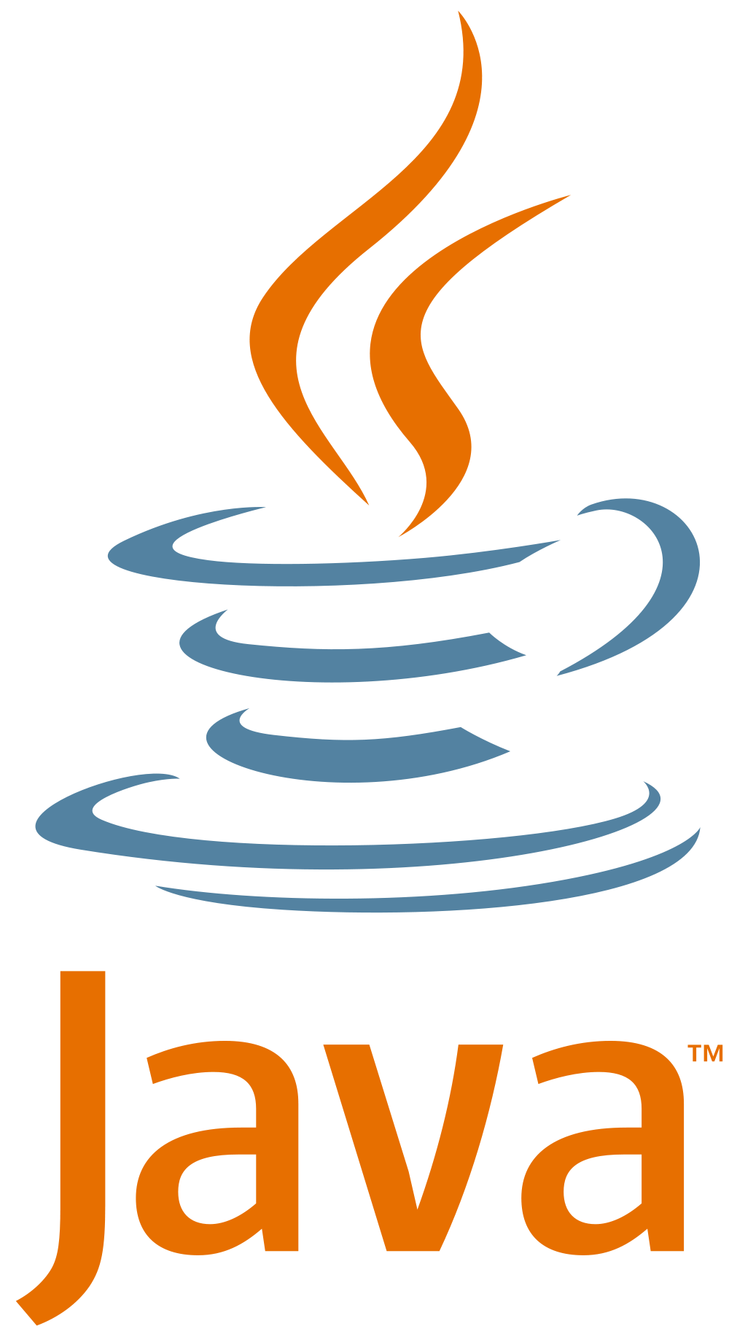





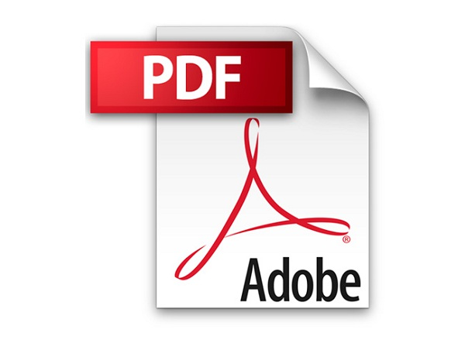



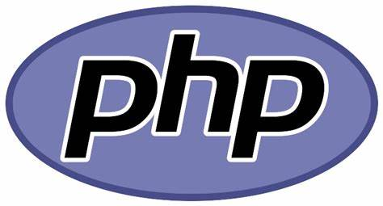
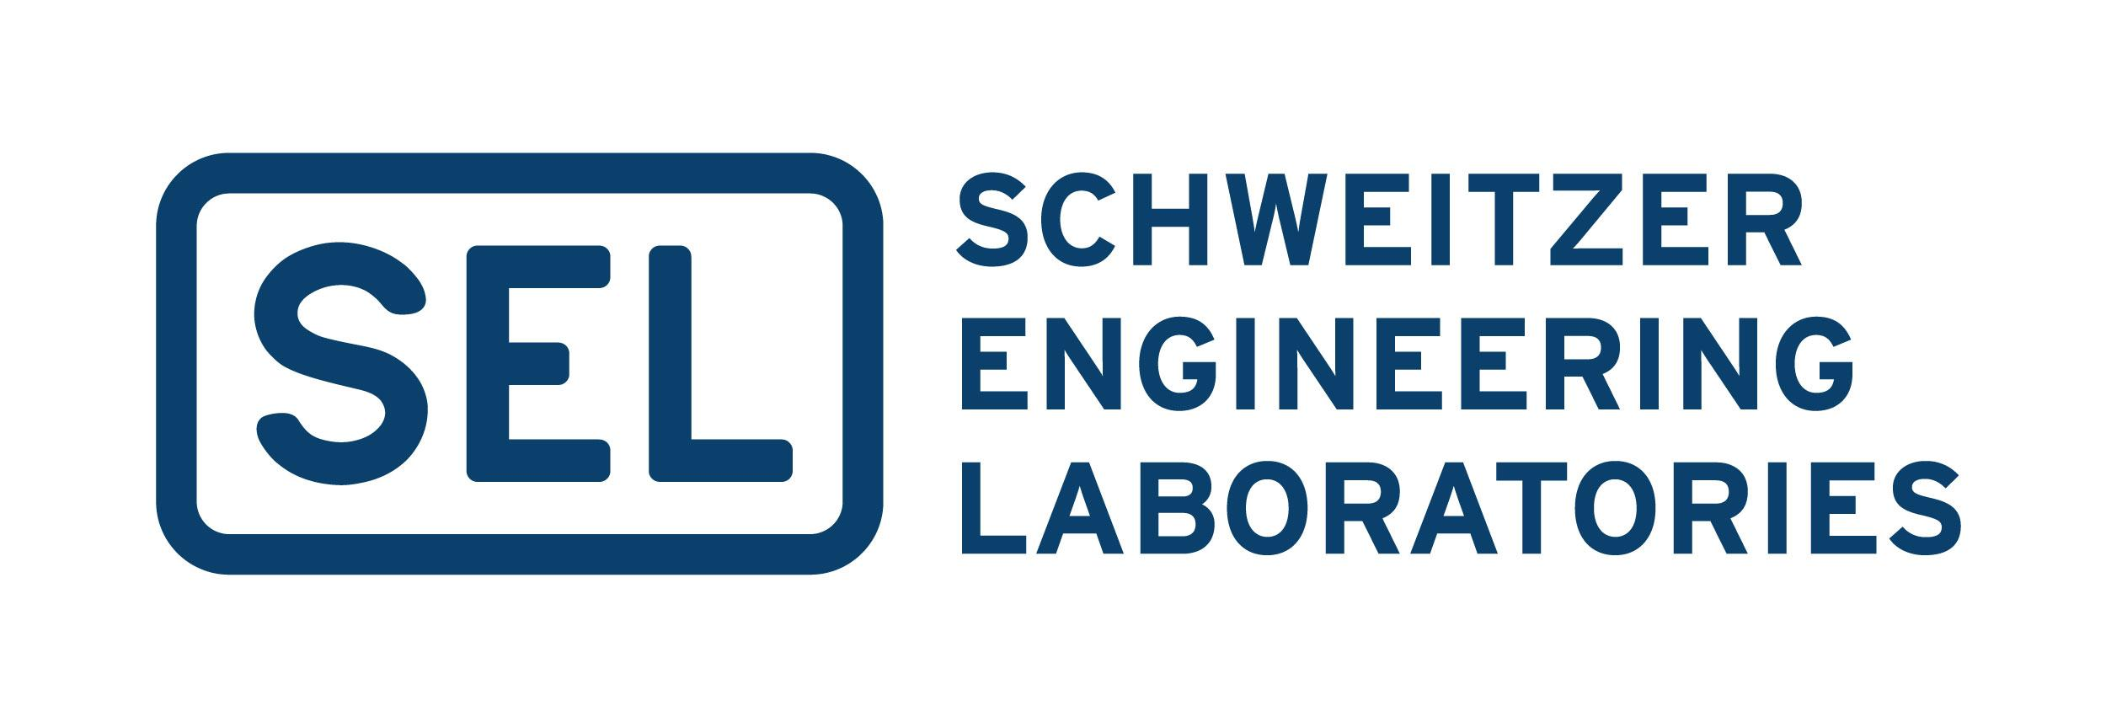
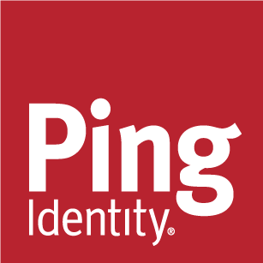


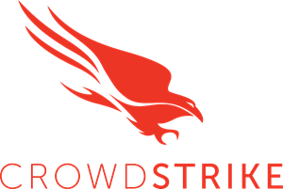

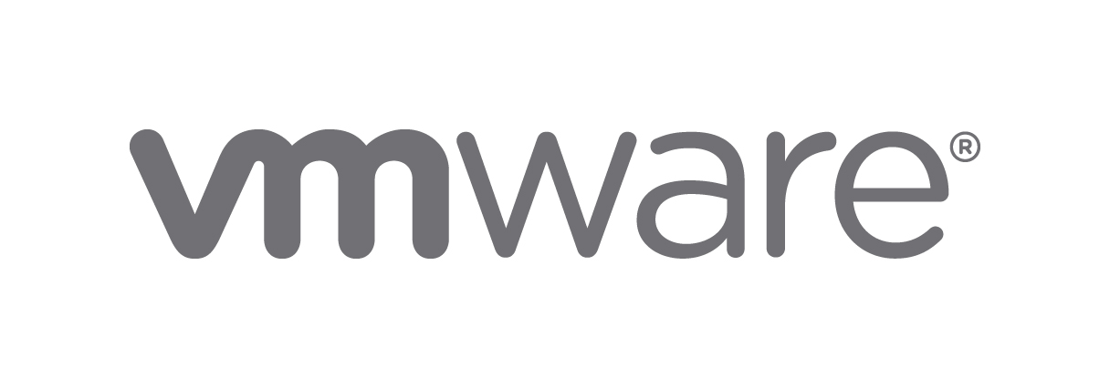
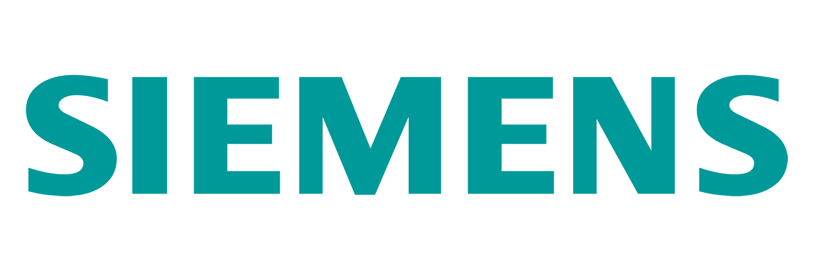


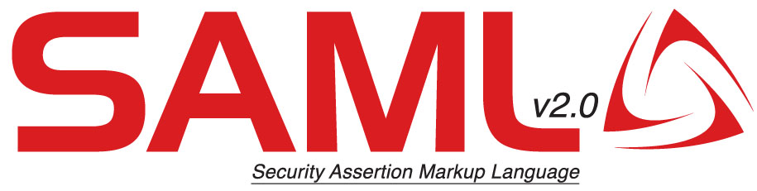
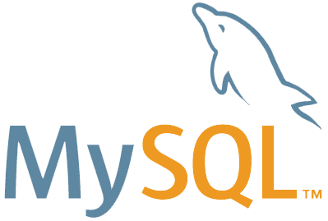






Security Operations
Legend
Outsourcing
Event Log Based Monitoring
Consulting and Escalation
Microsoft Reference Architecture
Investigation & Proactive Hunting
Native Resource Monitoring
May 2021 – https://aka.ms/MCRA
Align to Mission + Continuously Improve
Responsiveness - Mean Time to Acknowledge (MTTA)
Effectiveness- Mean Time to Remediate (MTTR)
Broad Enterprise View
Correlated/Unified Incident View
Azure Sentinel
Expert Assistance
Enabling analysts with scarce skills
Machine Learning (ML) & AI
Behavioral Analytics (UEBA)
(Case Management
Security Orchestration, Automation, and Remediation (SOAR)
Analysts and Hunters
Microsoft Threat Experts
Incident Response & Recovery
Security Data Lake
Security Incident & Event Management (SIEM)
Managed Detection and Response
Using Microsoft Security
(Classic SIEM
API integration
Microsoft Threat Intelligence 8+ Trillion signals per day of security context & Human Expertise
SOAR reduces analyst effort/time per incident, increasing overall SOC capacity
Deep Insights Actionable alerts from an XDR tool with deep knowledge of assets and ML/UEBA
Extended Detection and Response (XDR)
Security & Network
SOAR - Automated investigation and response (AutoIR)
Provide actionable security alerts, raw logs, or both
Azure Defender
Microsoft 365 Defender
Servers & VMs
Containers
Azure app services
Network traffic
SQL
IoT & OT
Defender for Identity
Azure AD Identity Protection
Defender for Endpoint
Defender for Office 365
Microsoft Cloud App Security
Infrastructure & Apps
PaaS
OT & IoT
Identity & Access Management
Endpoint & Mobile
Modern & SaaS Applications
Information
Raw Data Security & Activity Logs
Office 365
{LDAP}

Slide 57
Demo
Azure Sentinel
Notes:
SOC Process Workbook
Incidents
Show an incident
TI map IP entity to AzureActivity (enriched)
Security efficiency workbook
Threat Intelligence
TI Workbook
Workbooks
Identity & Access
Entity Behavior
JeffL
Vict00
Hunting
Run all queries
Data Connectors
AAD
Automation
Automate-Isolate-MDATPMAchine
Community

Slide 58

Metrics

Slide 59
Migration to the Cloud
Existing Environment
Side-by-Side
Cloud-Native
All logs to On-Prem
Side-by-Side
All logs to the Cloud
All alerts to On-Prem

Slide 60
Key Topics of a Modern SOC
Tooling
Use the right tool for the job
Culture
Reduce toil
Metrics
Measure the right things

Slide 61
Thank you
Roger Halbheer
roger.halbheer@microsoft.com
+41 78 844 65 55

Slide 62
SecDevOps

Slide 63
The way we build applications has changed
Past
Long application cycles
Monolithic apps
Servers and VMs
Less data
Desktop
Distinct infrastructure and operations teams
Today
Rapid innovation
Loosely-coupled apps, microservices, and containers
Serverless
Big Data
Mobile
Service-focused DevOps teams
On-Premises
Infrastructure Platform
IaaS
Infrastructure Platform
“lift & shift”
CaaS
Container Platform
PaaS
Application Platform
FaaS
Serverless Platform

Slide 64
Product innovations need to reach customers quickly, and stay available
Accelerate
delivery
Optimize
reliability

Slide 65
In other words:
“Change plane engine on air”

Slide 66
Developers are at the heart of a company’s innovation
Increase productivity
Accelerate collaboration

Slide 67


Software delivery paradox
Speed vs. control impedes innovation
SPEED
Innovation
Reliability
CONTROL

Slide 68
What is DevOps?
People. Process. Products.
Build& Test
Deploy
DevOps is the union of people, process, and products to enable continuous delivery of value to your end users.
“
Continuous Delivery
Develop
Operate
”
Plan & Track
Monitor & Learn

Slide 69
Agile vs. DevOps
Customer
+
Software Requirements
Developer
+
Tester
Operations
+
IT Infrastructure
Solution: Agile
Solution: DevOps
Agile addresses gaps in Customer and Developer communications
DevOps addresses gaps in Developer and IT Operations communications

Slide 70
Culture Change – Evolve the Organization
Program Management
Development
Test

Slide 71
Culture Change – Evolve the Organization
Program Management
Engineering
Operations
Site Reliability Engineering

Slide 72
Culture Change – Evolve the Organization
Feature Team
Feature Team
Feature Team

Slide 73
Instead of Horizontal
User Interface
API
Data

Slide 74
Got to Vertical
User Interface
API
Data

Slide 75




DevOps Capabilities and Practices
Culture
Lean Product
Architecture
Technology
Continuous
Planning
Continuous
Integration
Continuous
Delivery
Continuous
Operations
Continuous
Quality
Continuous
Security
Continuous
Collaboration
Continuous
Improvement
Continuous security
Security architecture
Access & identity management
Application & data security
Security infrastructure
Secure operations
Governance, risk, & compliance

Slide 76
DevOps Capabilities and Practices
Continuous planning
Continuous integration
Continuous delivery
Continuous operations
Objectives & Key Results (OKR)
Lean product discovery
Lean product definition
Release planning
Sprint planning
Agile requirements
Security requirements
Architecture design
Capacity planning
UX architecture design
Threat modeling
Prioritization & estimation
Demos & Retrospectives
Behavior-driven development (BDD)
Test-driven development (TDD)
Microservices & container development
Mono-repo & Multi-repo
Unit testing & code coverage
Version control
Git pull request
Trunk-based policies
Security static code scan
CredScan
Open Source software (OSS) component compliance
Build parallel & serial pipeline
Release pipeline
Secure infrastructure deployment
IaaS deployment
PaaS deployment
SaaS deployment
Shared services
Infrastructure as code (IaC)
Change management
Configuration management
Release management
Blue-green deployments
Canary deployments
Feature flags
Trunk production ready
Site reliability engineering (SRE)
Telemetry & monitoring
Application performance monitoring
Auto Failover, scaling, & DR
Modern service management
Secure access & application data
High availability, security, cost & performance advisory
Secure DevOps ChatOps
Shift-right testing
Secrets management
Governance & GDPR support
Automation & AIOps
Continuity & resilience
Continuous quality
Quality requirements
Shift-left testing
Governance
& standards
Test
automation
Compliance
& audits
Shift right
testing
Continuous security
Security architecture
Access & identity management
Application & data security
Security infrastructure
Secure operations
Governance, risk, & compliance
Continuous collaboration
Collaborative culture
Alignment & autonomy
Kanban collaboration
Wiki & Teams collaboration
ChatOps collaboration
Feature Team & SRE
Continuous improvement
Lead time & cycle time
Deployment frequency
Mean time to restore (MTTR)
Change fail percentage
Continuous feedback
Value stream mapping

Slide 77
Principles to Secure the Software Supply Chain
Apply policies and controls proactively
Rely on security automation
Build security checks into your CI/CD pipelines
Strengthen your security posture

Slide 78
From Development to Production
Key security practices:
Pre-commit
Commit (CI)
Deploy (CD)
Analyze
Operate
Threat modeling
IDE security plug-in
Pre-commit hooks
Secure coding standards
Peer review
Static code analysis
Security unit tests
Dependency management
Infra as code (IaC)
Security scanning
Cloud configuration
Security acceptance tests
Security Smoke tests
Configuration checks
Penetration tests
Continuous monitoring
Threat intelligence
Penetration testing
Blameless postmortems

Slide 79


Secure the Developer
End-to-end Protection
For Privileged Sessions
Enterprise Security
Specialized Security
Privileged Security
Baseline security for assets + starting point for higher security
Enhanced security profile for higher value assets
Strongest security for highest impact assets and accounts
Role Recommendation
For privileged access role
Standard users
High impact users / developers
IT Operations
Device
Physical device initiating session
Enterprise Device
Specialized Device
Privileged Access Workstation (PAW)
Account
with access to resources
Enterprise Account
Specialized Account
Privileged Account
Session
Intermediary
Remote Access / Admin Broker
Enterprise Intermediary
Specialized Intermediary
Privileged Intermediary
Interface
Controlling resource access
Enterprise Interface
Specialized Interface
Privileged Interface
Cloud Considerations
Protect cloud (and other) resources - Guidelines apply to Microsoft clouds, 3rd party clouds, and on-premises
Cloud is the security provider - Cloud management and security services are used for all (when technically feasible)

Slide 80
Understand the Threats
Define security requirements
Create an application diagram
Identify threats
Mitigate threats
Validate that threats have been mitigated
Microsoft Security Development Lifecycle Threat Modelling

Slide 81


Threat Modelling Tool
Microsoft Threat Modeling Tool overview - Azure | Microsoft Docs

Slide 82

Threats Manager Studio
Home - Threats Manager Studio

Slide 83

Secure your Code
Find hard-coded secrets in your code
Scan your entire source code history for hard-coded credentials that present privilege escalation risks.
Prevent new vulns from being introduced
Use GitHub code scanning and CodeQL to detect new vulnerabilities automatically. Scan every change to your code, and surface only new results.
Get notified about hard-coded secrets and take action
Global community for security
Take advantage of the hundreds of CodeQL queries written and open sourced by world leading security teams.

Slide 84



Secure your Dependencies
Know your environment
Compatibility score from other users on GitHub.com who have updated to the same version.
Understand the open source, inner source and commercial components in your projects, their licenses, and any known vulnerabilities in them.
Manage your dependencies
Identify when dependencies are changing and ensure those changes do not introduce vulnerabilities or incompatible licenses.
Understand the dependencies you rely on
Merge automated pull requests to keep dependencies secure & up-to-date
Respond fast to new vulnerabilities
Get notified of new vulnerabilities as soon as they're discovered and receive automated updates from Dependabot to patch your projects.

Slide 85

Secure your Workflow
With GitHub Actions
Orchestrate policy integration
Easily manage Azure Policies “as code” from a GitHub repository in an orchestrated manner.
Scan containers
Scan for common vulnerabilities in Docker images before pushing them to a container registry or deploying them to a containerized web app or Kubernetes cluster.
Manage secrets using Azure Key Vault
Dynamically pull secrets from an Azure Key Vault instance for consumption in GitHub Action workflows.

Slide 86







Cloud-Native Controls
Multi-cloud & hybrid protection in Azure Security Center
Google Cloud
Amazon Web Services
On-prem
Microsoft Azure
New!
New!
New!
Azure Arc
Security posture & compliance
Secure score
Asset management
Policy
Server protection
(Azure Defender for VMs)
Threat detection
VA (power by Qualys)
Application control
Automation & management at scale
Automation
SIEM integration
Export

Slide 87







Native Security for Azure
Management Plane Security Platform provided security guardrails, governance, policy, and more
Azure Cloud Adoption Framework (CAF)
Guidance on security strategy, planning, roles and responsibilities https://aka.ms/CAF
Top 10 Azure Security Best Practices
Azure Blueprints
Azure Policy
Management Groups
Role Based Access Control (RBAC)
Azure AD Identity Governance
Azure Security Center
Azure Lighthouse
Resource Locks
Azure Backup & Site Recovery
Governance &
Policy Enforcement
Automated User Provisioning
Entitlement Management
Access Reviews
Privileged Identity Management (PIM)
Terms of Use
Data Plane Security Per-Application/Workload Controls
Enable Zero Trust Networking & Secure Access Service Edge (SASE)
Microsoft Endpoint Manager
Zero Trust Access Control
Explicit trust validation for users and devices before allowing access
Internal Communications (East/West)
External Communications (North/South)
Control
Intune
Azure Well Architected Framework (WAF)
Network/App Security Groups
API Management Gateway
Configuration Manager
Azure AD App Proxy
PrivateLink & Service Endpoints
Azure DDoS and Web Application Firewall (WAF)
Preventive Controls
Azure Bastion
MFA and Passwordless
Azure AD Privileged Identity Management (PIM)
Azure Security Benchmarks (ASB)
Prescriptive Best Practices and Controls
Encryption & Azure Key Vault, Application RBAC Model
Microsoft 365 Defender
Azure AD MFA
Azure AD Identity Protection
Azure Firewall and Firewall Management
Windows Hello
Azure AD Conditional Access
Azure DevOps Security
Full Time Employees, Partners, and/or outsourced providers
Privileged Access Workstation (PAW)
Existing MFA
Microsoft Cloud App Security
GitHub Advanced Security
Business Users
Access Applications
On-Premises & Other Cloud Resources/Data
Azure AD B2C
Developers
CI/CD Pipeline
Application
Customers (and ‘External’ Partners)
Administrators
Azure Active Directory (AD) and B2B
Azure Resource Management (ARM)
On-Premises & Other Cloud Resources/Data
API
App/Service and Automation
Active Directory
Azure Portal
Azure Sphere
Command Line Interface (CLI)
Azure IoT Hub
Internet of Things (IoT) Devices
Automation/API
Existing/Other
‘Internal’ Access
Workstations
Accounts
Identity
Access and Privileges
Interface
Infrastructure
Resource
Network & ‘External’ Access
Microsoft Secure Score
Azure Security Center (ASC) - Risk & Regulatory Compliance Reporting
Risk Factors & Governance
Microsoft 365 Defender
Azure Policy (audit) & Azure resource graph API
Microsoft Defender for Endpoint
Azure AD Identity Protection
Microsoft Defender for Identity
Azure Defender - Detections across assets and tenants
Threat Detection
Azure Sentinel Threat detection, investigation, remediation, and hunting
Microsoft Cloud App Security (MCAS)
Azure WAF Alerts
VMs & Tenants (Azure, On-prem, 3rd party clouds)
Containers and Kubernetes
IoT and Legacy OT Devices (SCADA, ICS, etc.)
Azure SQL & Cosmos DB
Azure Storage Accounts
And More…
Visibility
MCAS Alerts
Azure Firewall Alerts
Security Incident & Event Management (SIEM)
Security Orchestration, Automation, and Remediation (SOAR)
Unified Entity Behavioral Analytics (UEBA)
Machine Learning (ML) & Artificial Intelligence (AI)
Security Data Lake
Azure DDOS Alerts
MCAS Logs
Application Logs
Raw Logs and Signal for Investigation & Hunting
Endpoint logs
Azure AD logs, access logs, alerts, risk scoring
PIM Logs
Network Watcher – IP Flow logs, Packet Capture, Virtual TAP
Azure activity log
Azure Service Diagnostic Logs & Metrics

Slide 88
SecDevOps
This is a culture change
Create agile security
Do not overdo policies
Leverage cloud native controls

Slide 89
Thank you
Roger Halbheer
roger.halbheer@microsoft.com
+41 78 844 65 55

Slide 90
Cloud Security

Slide 91
Transforming Legacy to the Cloud
Risk
Patching
Sandboxing
Scanning
Segmentation
Encryption
Secure Development Lifecycle
Forensics
Threat Protection
Logging & Analytics
Orchestration & Automation
SIEM
Architectures change, but principles & outcomes remain the same
WAFs
Vulnerability Management
Firewalls
TLS
Information Protection
Threat Intelligence
Roles, responsibilities, and skillsets will evolve
Same
Changed
New
Controls, tools, and processes will evolve
Note: Legacy ‘technical debt’ persists with legacy workloads/applications in IaaS

Slide 92
“Bad Neighborhood” on the Internet
Attacker for hire (per job)
$250 per job (and up)
Ransomware Kits
$66 upfront (or 30% of the profit / affiliate model)
Compromised PCs / Devices
PC: $0.13 to $0.89
Mobile: $0.82 to $2.78
Spearphishing for hire
$100 to $1,000 (per successful account takeover)
Attackers
Stolen Passwords
$0.97 per 1,000 (average)
(Bulk: $150 for 400M)
Denial of Service
$766.67 per month

Slide 93
Azure Capabilities and Guidance
Attacker for hire (per job)
$250 per job (and up)
Existing Control-Framework
Ransomware Kits
$66 upfront (or 30% of the profit / affiliate model)
Compromised PCs / Devices
PC: $0.13 to $0.89
Mobile: $0.82 to $2.78
Control Objectives
Spearphishing for hire
$100 to $1,000 (per successful account takeover)
Stolen Passwords
$0.97 per 1,000 (average)
(Bulk: $150 for 400M)
Denial of Service
$766.67 per month
Native Security Controls and integration with existing security capabilities
Attackers

Slide 94
Azure Capabilities and Guidance
Attacker for hire (per job)
$250 per job (and up)
Azure Security Guidance
Native Security Controls and integration with existing security capabilities
Ransomware Kits
$66 upfront (or 30% of the profit / affiliate model)
Native Threat Detection (& SIEM)
Secure Azure, Azure AD, Windows, Linux, iOS, Android, SaaS apps + correlate with cloud native SIEM+SOAR+UEBA (Azure Sentinel)
Top 10 Best practices
Top 10 Best practices
Compromised PCs / Devices
PC: $0.13 to $0.89
Mobile: $0.82 to $2.78
Spearphishing for hire
$100 to $1,000 (per successful account takeover)
Passwordless and Multi-factor Authentication (MFA)
Defeat popular and effective identity and password attacks with biometrics, hardware security, and threat intelligence
Azure Security Benchmarks
Stolen Passwords
$0.97 per 1,000 (average)
(Bulk: $150 for 400M)
Cloud Adoption Framework(CAF)
Well Architected Framework (WAF)
Denial of Service
$766.67 per month
Native Firewall and Network Security
Protect business-critical assets with Azure Firewall, DDoS protection, & integrated web application firewall (WAF)
→
Attackers
Industry Collaboration
with customers, NIST, CIS, The Open Group, and others
→
+

Slide 95



Common Adoption Strategies
Future Investment
1
Prefer SaaS Take advantage of productivity workloads provided in the cloud
No
Yes
2
New Development to PaaS New development and modern applications move to PaaS.
New applications optimized for cloud computing.
Saas offering available
No
Yes
Saas Evaluation
(Build/buy decision)
Passes PaaS Evaluation
Passes IaaS Evaluation
3
Existing workloads → IaaS Existing applications move to IaaS using a ‘lift and shift’ strategy
Build
No
No
Buy
Yes
Yes
3a
→ Convert to PaaS Plan to refactor applications into PaaS
SaaS Hotel room
PaaS Furnished apartment
IaaS Rental apartment
Private Cloud Private House

Slide 96
Shared Responsibility
Responsibility | SaaS | PaaS | IaaS | On-prem
Information and Data
Devices (Mobile and PCs)
Accounts and Identities
Identity and directory infrastructure
Applications
Network Controls
Operating system
Physical hosts
Physical network
Physical datacenter
Establish a Modern Perimeter
Modernize Infrastructure Security
“TRUST BUT VERIFY” EACH Cloud Provider
 | Microsoft |  | Customer

Slide 97
Microsoft’s Cloud Transformation
What we learned
Security wasn’t the main blocker
A focus on culture and mindset from the beginning was needed to change behaviors
FFUUEE
Fear fair
Understand urgent
Entitled exhausted
Capex → Opex
Security and reliability
Retire it, right-size, eliminate environments
~30%
Use or convert to a SaaS (1st or 3rd party) solution
~15%
Expose functionality in existing SaaS/PaaS solution
Simple and new
High I/O or Biz Impact
Hard or costly
~35%
Convert to Azure PaaS solution
~10%
Optimize for and move to Azure IaaS VM
~5%
No change, lift‘n shift to IaaS
Remain on-premise
<5%

Slide 98
Top 10 Essential Cloud Security Decisions
People
Process
Technology
Foundational Architecture Decisions

Slide 99
Top 10 Essential Cloud Security Decisions
People
Process
Technology
1
Foundational Architecture Decisions
Educate on Cloud Journey
Culture, threats, shared responsibility, etc.
2
Educate on Cloud Technology
Architecture, services, security controls, etc.

Slide 100
Top 10 Essential Cloud Security Decisions
People
Process
Technology
3
Foundational Architecture Decisions
Assign Accountability
Clear ownership of decisions and actions
4
Rapid incident response
Update processes to cloud platform
5
Posture Management
Assign Ownership, Automate, and Simplify

Slide 101
Top 10 Essential Cloud Security Decisions
People
Process
Technology
6
Foundational Architecture Decisions
Passwordless / Multi-Factor Authentication (MFA)
Strong authentication assurances
7
Native Network Security & Firewall
Simplify protection of systems and data
8
Native Threat Detection
Simplify Threat Detection and Response

Slide 102
Top 10 Essential Cloud Security Decisions
9
Single directory / identity
Simplifies monitoring & user experience - ….but separate accounts for admins!
People
Process
Technology
10
Identity access (instead of keys)
Avoid using key based access control
11
Single strategy
Align and integrate teams, processes
Foundational Architecture Decisions

Slide 103
Thank you
Roger Halbheer
roger.halbheer@microsoft.com
+41 78 844 65 55

